Slide 1
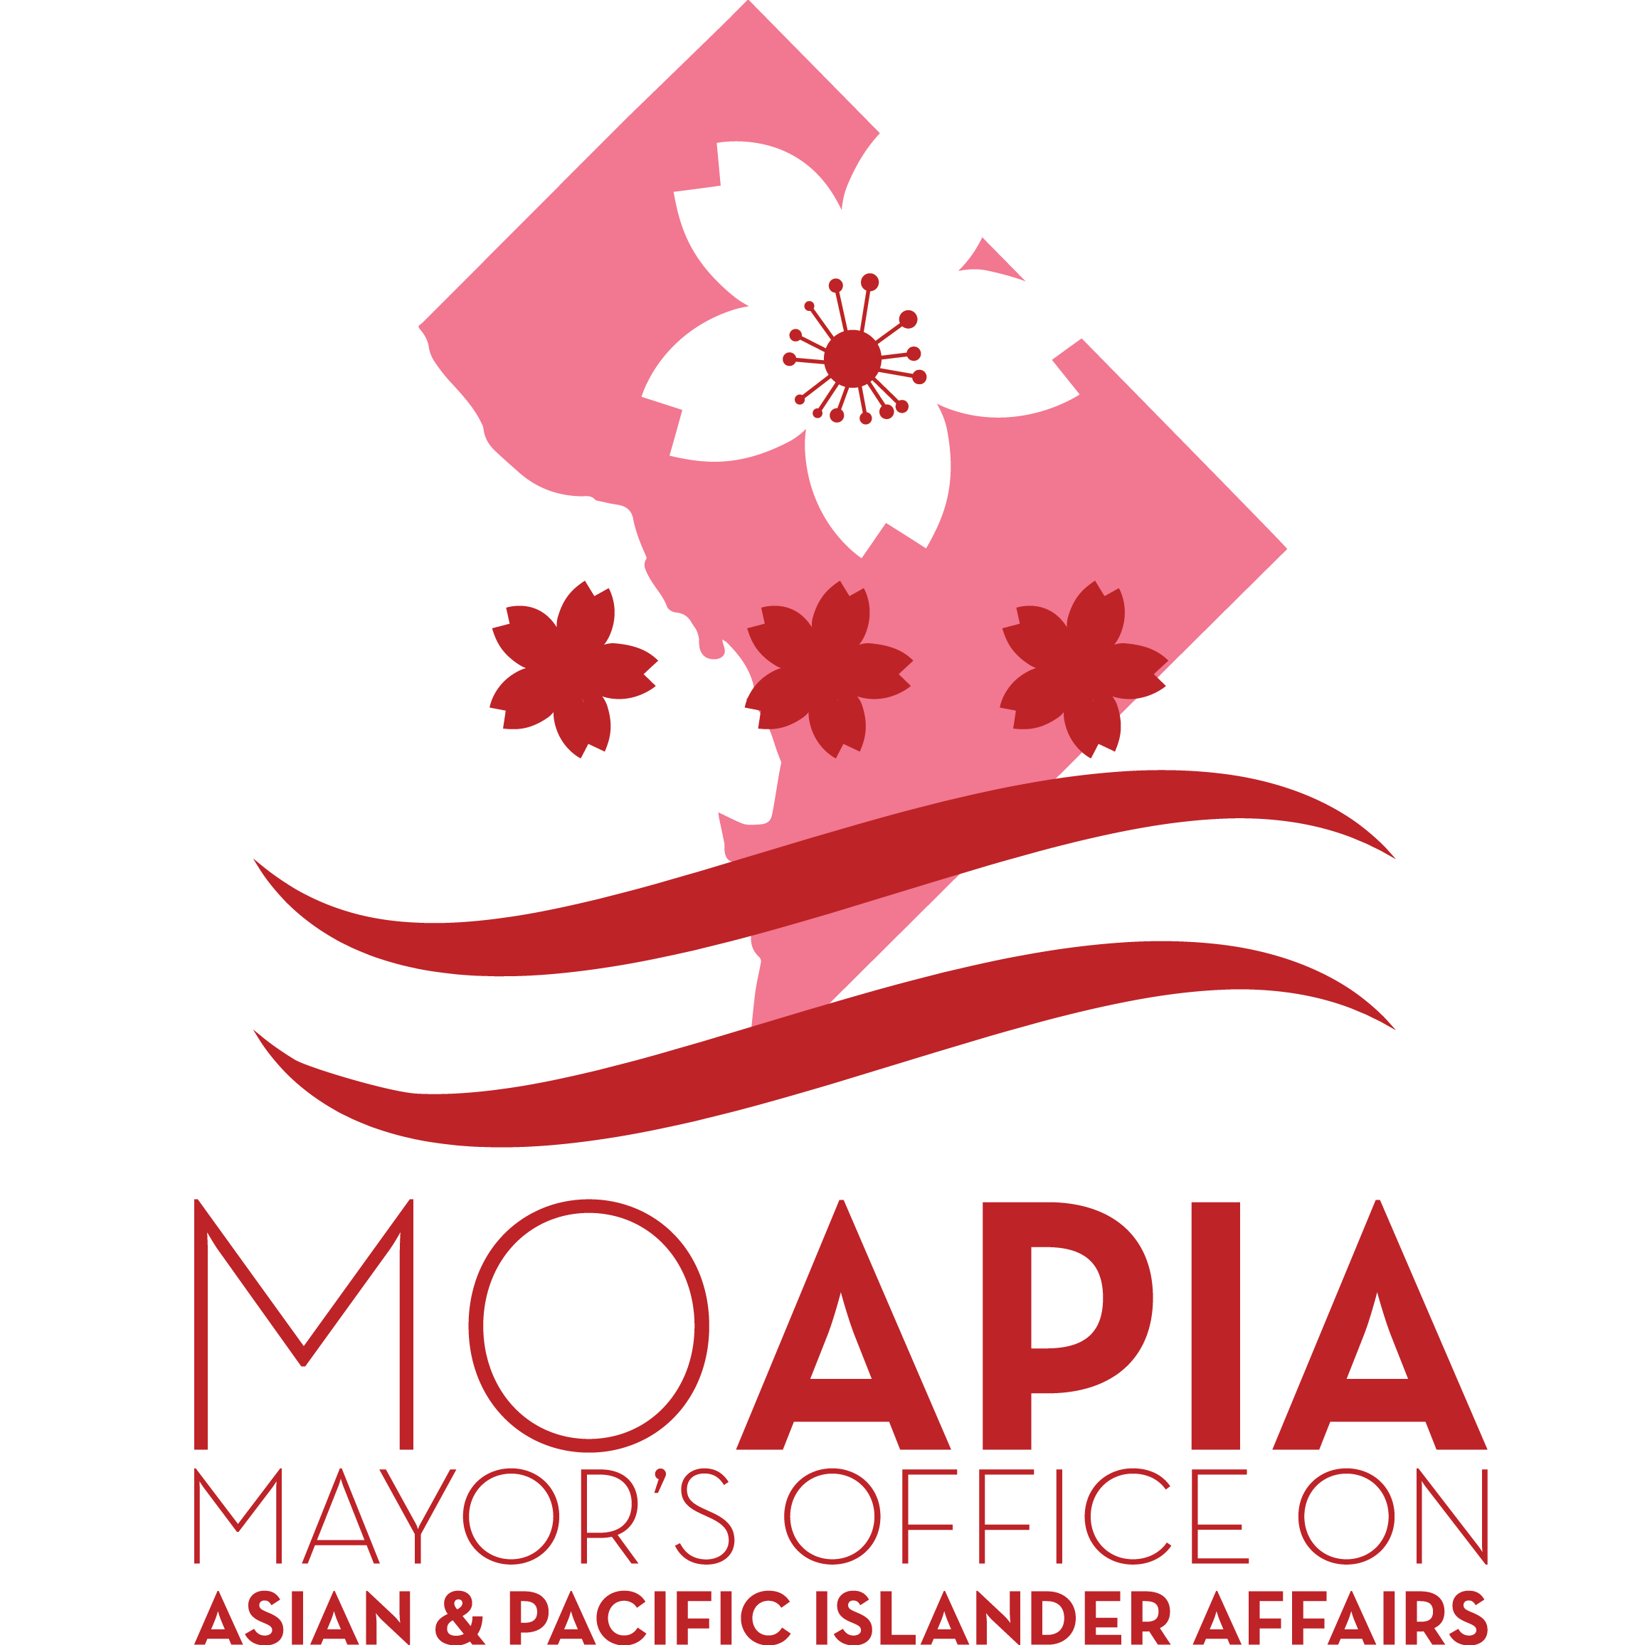
2018 Immigrant Justice Legal Services Grant: Pre-Bidders’ Meeting

Slide 2
Agenda
About the IJLS Grant
Request for Proposals
ZoomGrants
Frequently Asked Questions
Additional Q&A

Slide 3
About IJLS Grant
The Immigrant Justice Legal Services (IJLS) Grant Program is a $500,000 commitment from the Bowser Administration. This grant program is intended to fund programs that provide targeted services and resources to the DC immigrant population.

Slide 4
About IJLS Grant: Funding Areas
The program funds services in the following twelve categories:
Helping DC residents apply for green cards, convert green cards to citizenship, and make other affirmative USCIS filings;
Renewing DACA (Deferred Action for Childhood Arrivals) applications and work permits for DC residents;
Conducting Know Your Rights briefings and workshops;
Helping prepare asylum applications and provide legal representation at asylum interviews and/or hearings for DC residents; or, for clients in removal proceedings, prepare defensive asylum applications;
Representing youth who are in removal proceedings, but are not currently detained, provided representation began before the client turned 18;
Protecting financial assets and custody for DC children in the face of potential deportation of parents or guardians;

Slide 5
About IJLS Grant: Funding Areas (Cont.)
Helping people and businesses conduct affairs through ITIN numbers, appeal licensing board denials based on international qualifications, and access health insurance and other public benefits for which they are eligible;
Filing any lawsuits that may become necessary to challenging the use of DACA applications for finding or deporting undocumented persons;
Helping file applications for S, T, U, Special Immigrant Juvenile visas and Violence Against Women Act (VAWA) petitions for DC residents or family members of DC residents; and
Providing legal help for family reunification efforts for families with at least one DC resident;
Helping DC families adopt or provide foster homes for refugees and children from war-torn countries; and
Training and mentoring pro bono attorneys to perform any of the tasks 1-11.

Slide 6
Comparison to the 2017 IJLS Grant
2017 IJLS
Did not allow deportation defense
Allowed IJLS funds to support training/mentoring pro bono attorneys
2018 IJLS
Allows representation of youth who are in removal proceedings, but are not currently detained
Lists training/mentoring pro bono attorneys as an explicit purpose

Slide 7
About IJLS Grant: Target Population
The IJLS is designed to benefit all DC immigrants, regardless of immigration status. The IJLS will benefit immigrants of all ages – and national origins – who reside in DC, as well as families of mixed status who have at least one family member here and immigrant business owners in DC.

Slide 8
About IJLS Grant: Eligibility
IJLS is open to:
Community-based 501(c)(3) organizations;
Private entities that are partnering with 501 (c)(3) organization(s); or
Private entities that are mobilizing pro bono talent.
Individuals are not eligible for this grant.

Slide 9
About IJLS Grant: Awards
A total of $500,000 has been made available through this program.
Each grant will total no more than $150,000.
Up to 20 grants will be awarded to successful applicants.
Only one application per organization will be accepted, though law firms may partner with more than one CBO.

Slide 10
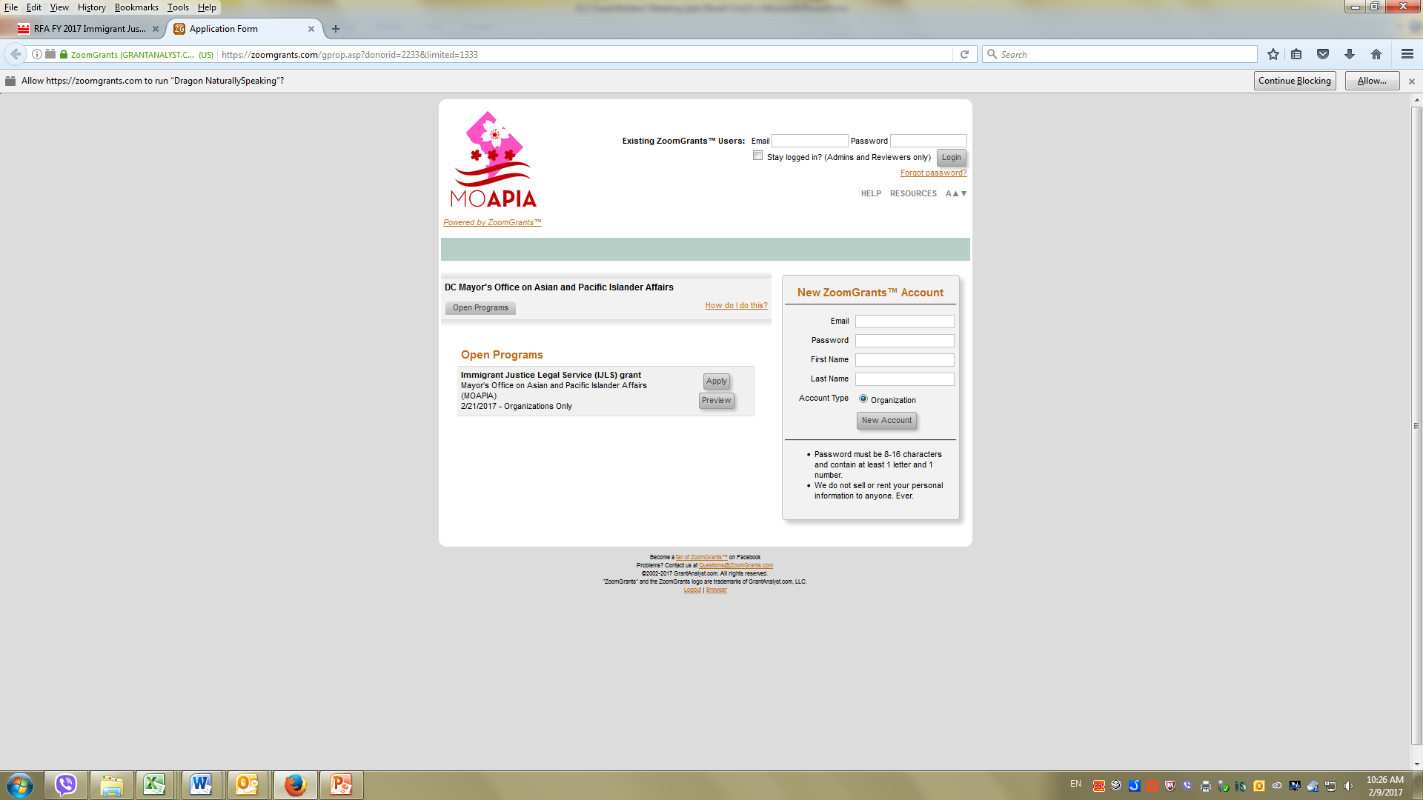
ZoomGrants Registration

Slide 11
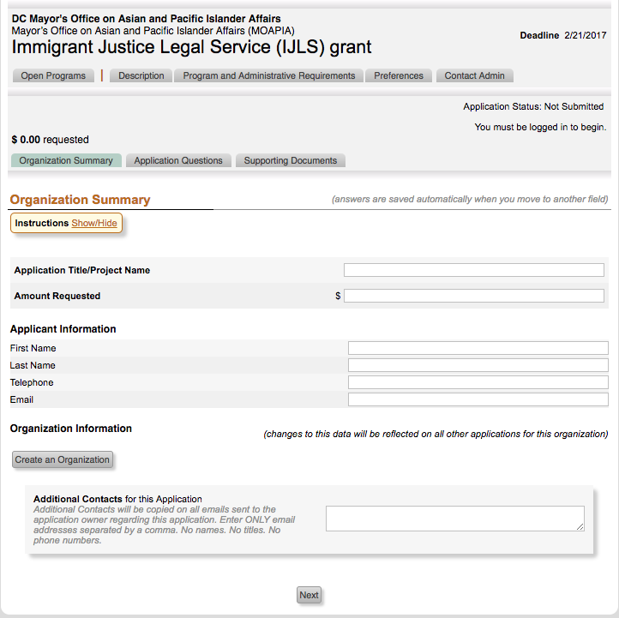
How to Apply using ZoomGrants
Step 1

Slide 12
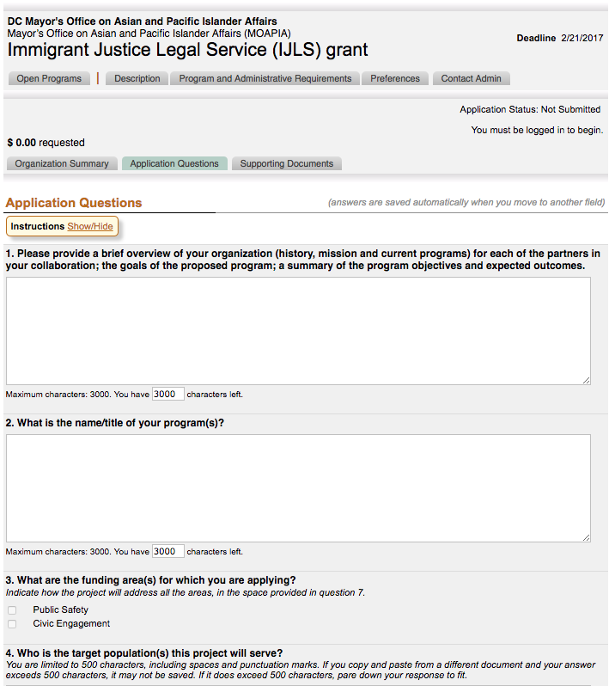
How to Apply for Zoom Grant
Step 2

Slide 13
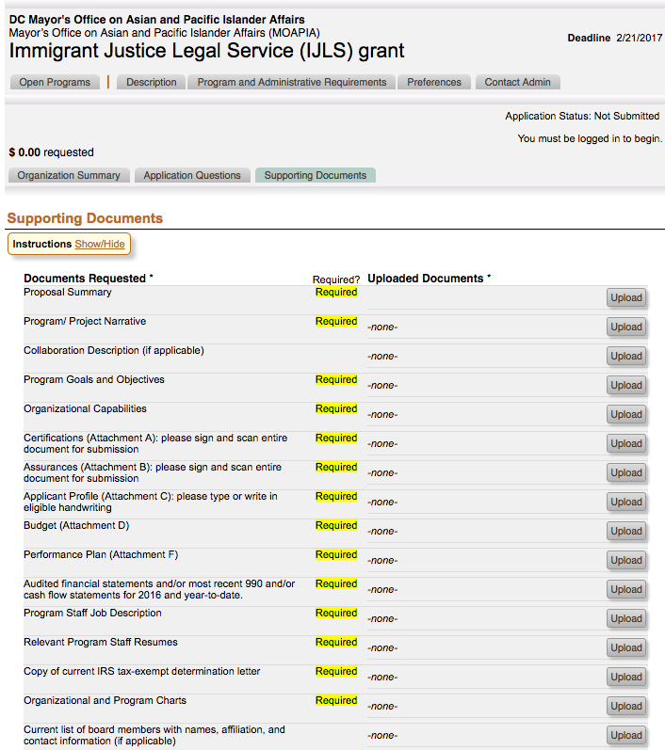
How to Apply for Zoom Grant
Step 3

Slide 14
Application Deadline
Deadline: Tuesday, August 29, 2017 5:00 pm EST
The only method to submit an application is through ZoomGrants.

Slide 15
Review FAQ list Additional Questions?

